Slide 1

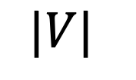




variable
5,000
0.2
4,000
0.4
3,000
0.6
Running time (sec)
0.8
2,000
1,000
0
$$2^{1}K$$
$$2^{2}K$$
$$2^{3}K$$
$$2^{4}K$$
$$2^{5}K$$
$$|V|$$

Slide 2
variable
5,000
0.2
4,000
0.4
3,000
0.6
Running time (sec)
0.8
2,000
1,000
0
$$2^{1}K$$
$$2^{2}K$$
$$2^{3}K$$
$$2^{4}K$$
$$2^{5}K$$
$$|V|$$

Slide 3
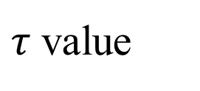
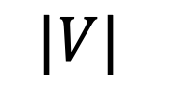
$τ$ value
5,000
0.8
4,000
0.6
3,000
0.4
Running time (sec)
0.2
2,000
1,000
0
$$2^{1}K$$
$$2^{2}K$$
$$2^{3}K$$
$$2^{4}K$$
$$2^{5}K$$
$$|V|$$

Slide 4




$τ$ value
5,000
$$5,300$$
0.8
4,000
$$5,100$$
0.6
3,000
0.4
$$4,900$$
Running time (sec)
$$2^{5}K$$
0.2
2,000
1,000
0
$$2^{1}K$$
$$2^{2}K$$
$$2^{3}K$$
$$2^{4}K$$
$$2^{5}K$$
$$|V|$$

